Slide 1
Templating, Forms
Returning Views, using Twig, submitting forms

Slide 2
Table of Contents
Templating
Forms

Slide 3
Templating
Templates and Twig

Slide 4
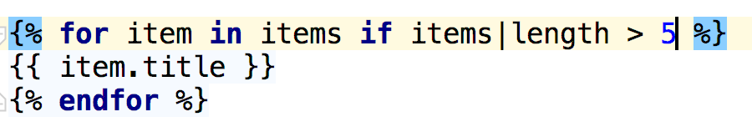
Templating
In Symfony you can use two type of templates
php - standard html + php code in our templates
twig - flexible template language

Slide 5
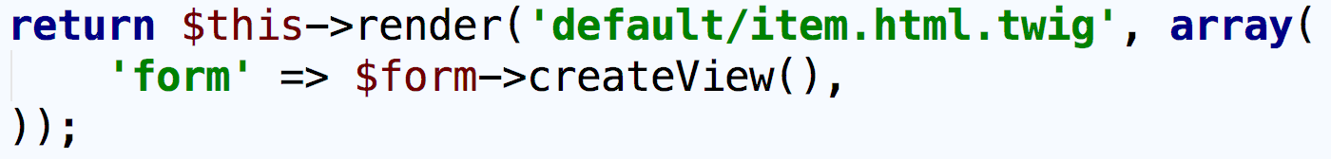
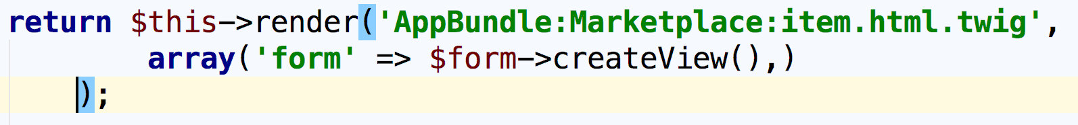
Templating
Templates Location
per application - templates can be accessed from any bundle
per bundle - templates can be accessed from any bundle
using the namespace notation

Slide 6
Templating
Templating language
Easier to read
Creates much cleaner templates
Combines iteration with condition
Allows inheritance between templates
Automatic escaping and raw output
Extensions

Slide 7
Templating
Twig and Controllers
pass parameters to template
$this->render() - render template and create Response object
$this->renderView() - render

Slide 8
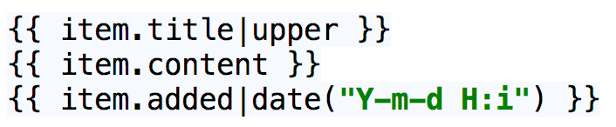
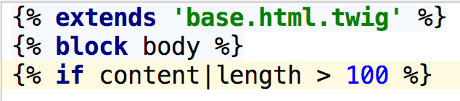
Templating
Twig
{{ … }} - print variable or text
{% ... %} - used for logic blocks
{# … #} - twig comment

Slide 9
Templating
What can we do with Twig?
extend template
combine conditional statements and loops
access object property with dot notation
generate links
override blocks, create macros, extend parent block
include another template
include assets
create custom twig extensions

Slide 10
Templating
What can we do with Twig?
app.user - get current user
app.request - get current request
app.session - get session
app.environment - get application environment
app.debug - check debug status of the application
access global twig variable - can create global twig variables and access them in your templates

Slide 11
Forms
Forms and Templates

Slide 12
Forms
Form flow:
create the form
set the data
handle request
do something with submitted data
save to database
remove from database
update database

Slide 13
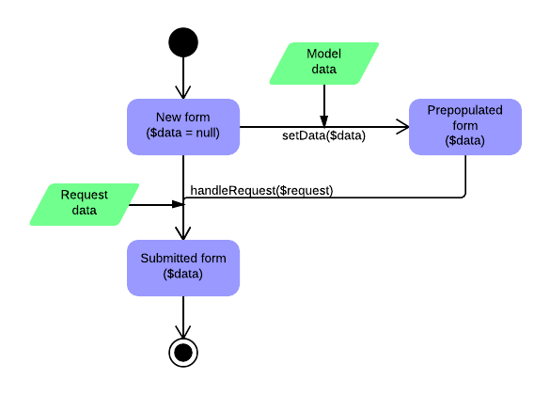

Forms
Form flow

Slide 14
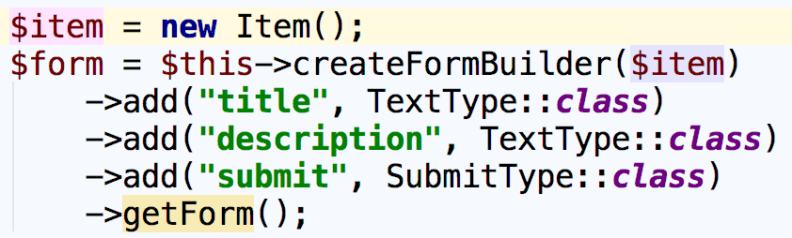
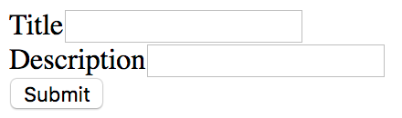
Forms
Two ways to create forms in Symfony
in your controller action using the form builder

Slide 15
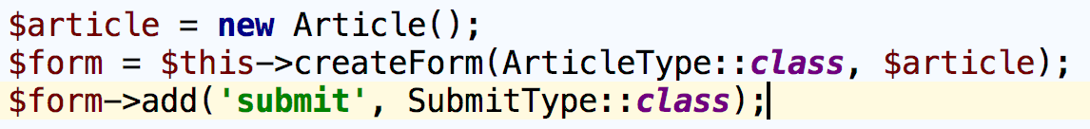
Forms
Two ways to create forms in Symfony
using separate form class

Slide 16
Forms
A form should know what input field to render
TextType - input type="text"
SubmitType - input type="submit"
ChoiceType - generates select, checkboxes or radio buttons
HiddenType - input type="hidden"
RepeatedType - used to render input fields for passwords and confirmation

Slide 17
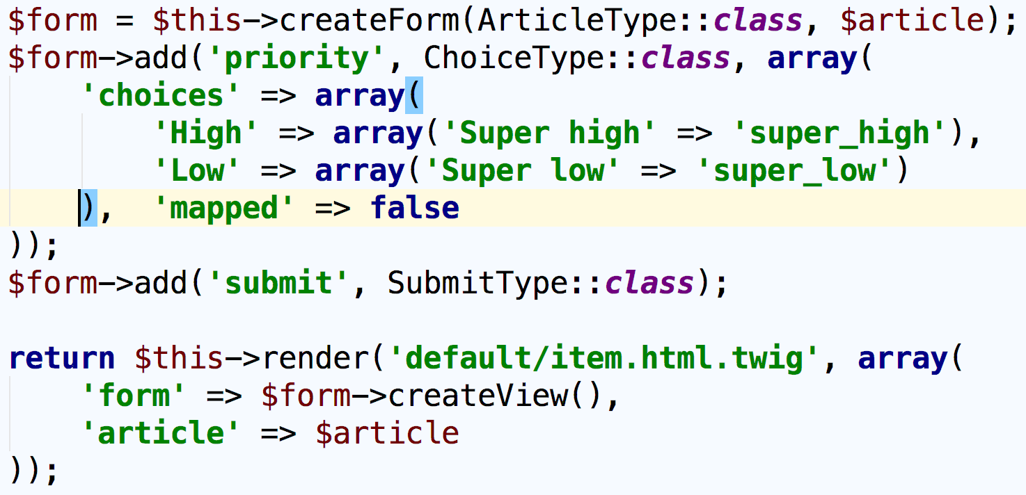
Forms
To display form in template it must be passed as view parameter

Slide 18
EXAMPLE

Slide 19
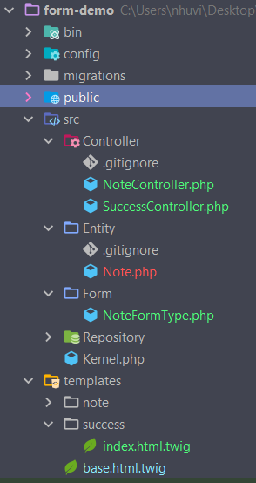
Folder Structure

Slide 20
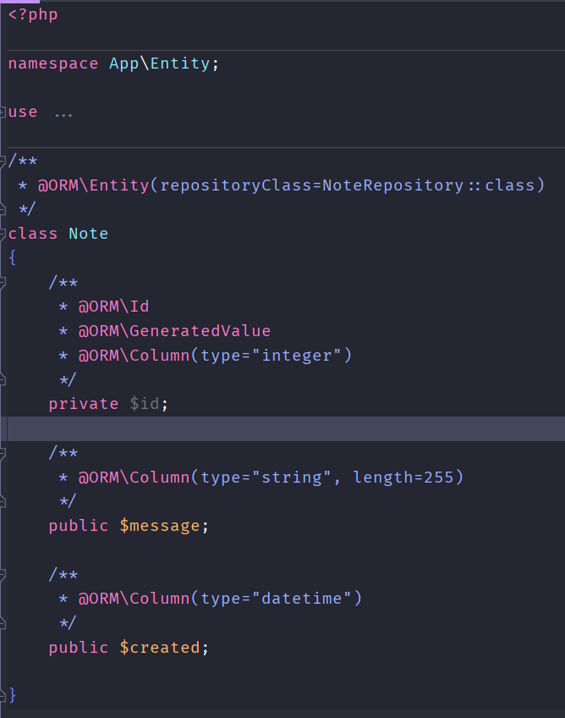
Note.php

Slide 21
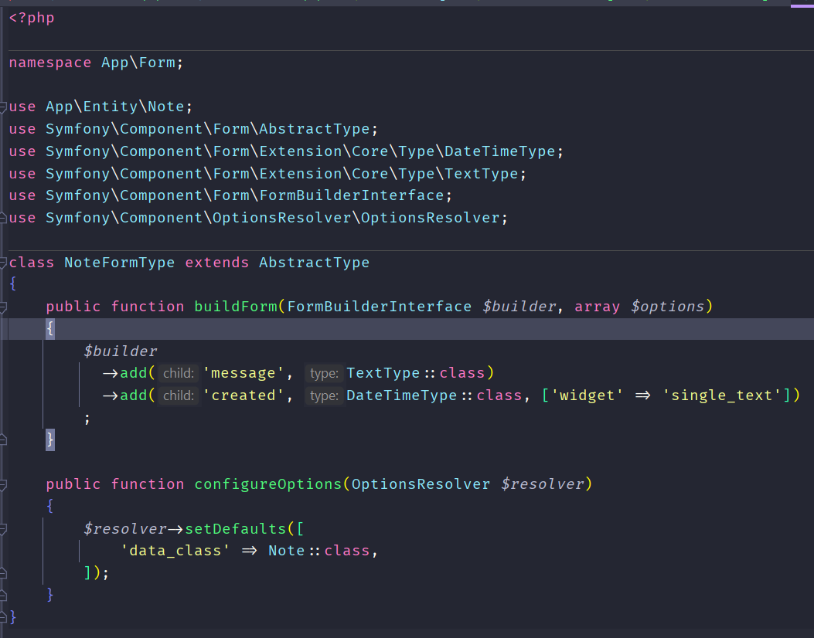
NoteFormType.php

Slide 22
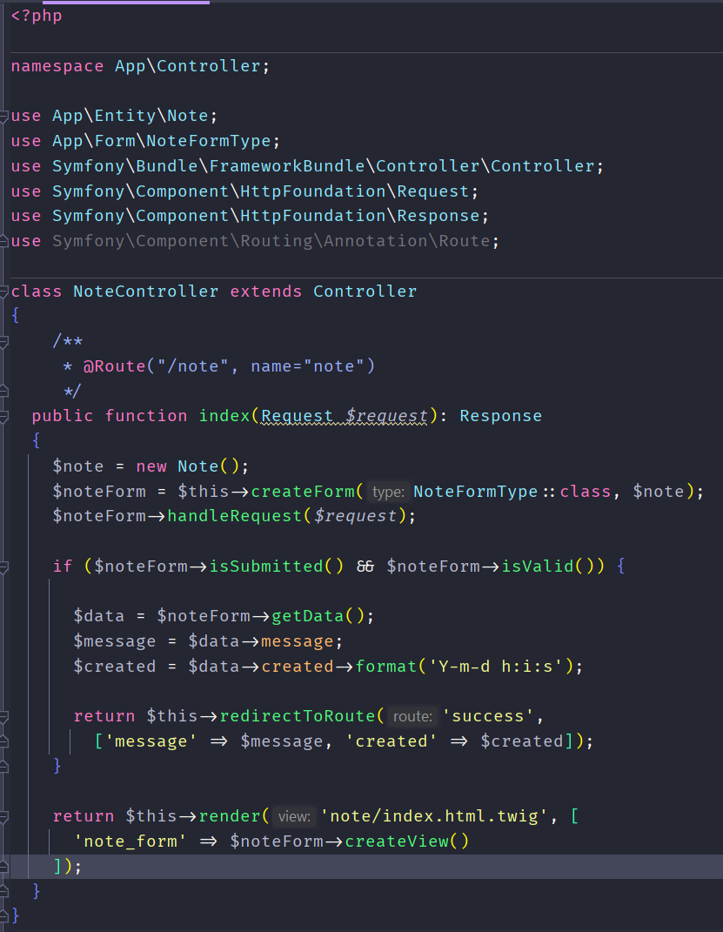
NoteController.php

Slide 23
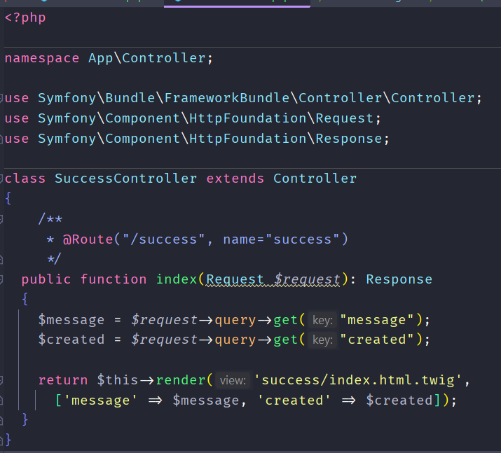
SuccessController.php

Slide 24
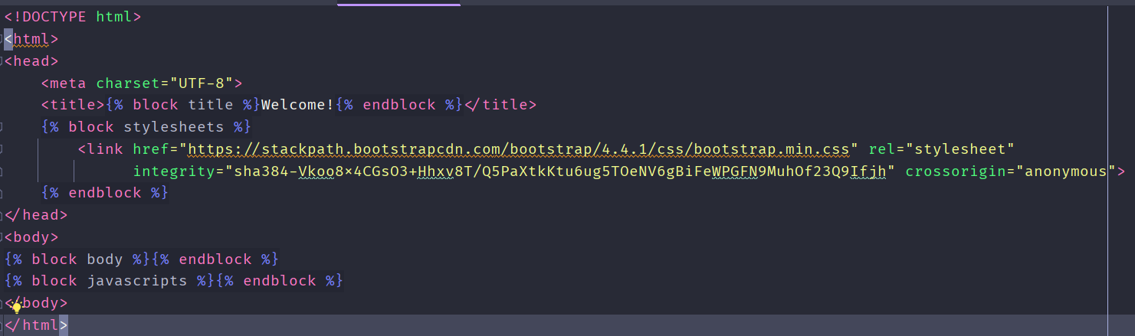
base.html.twig

Slide 25
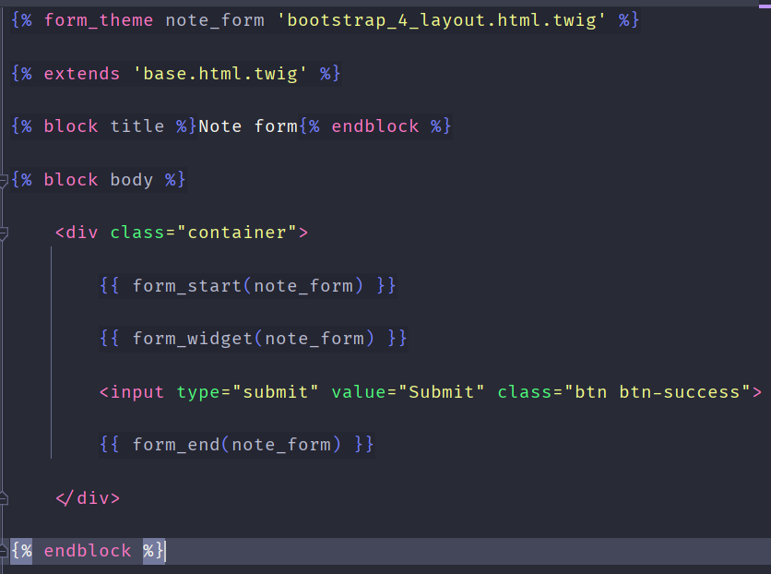
templates/note/index.html.twig

Slide 26
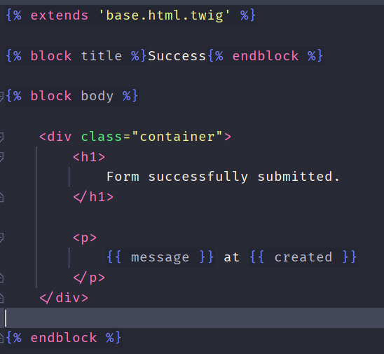
templates/success/index.html.twig

Slide 27
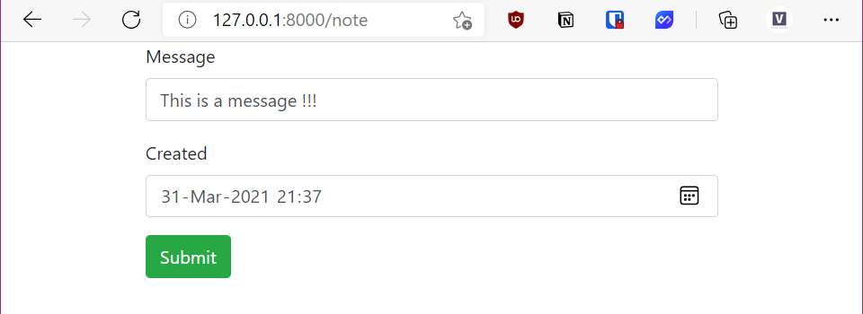
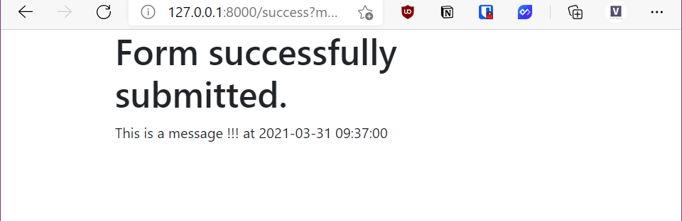
Result

Slide 28
Summary
Templating
Twig, extending templates, blocks
Twig extensions, macros
Forms
Rest concepts, REST URIs, Responses

